Slide 1
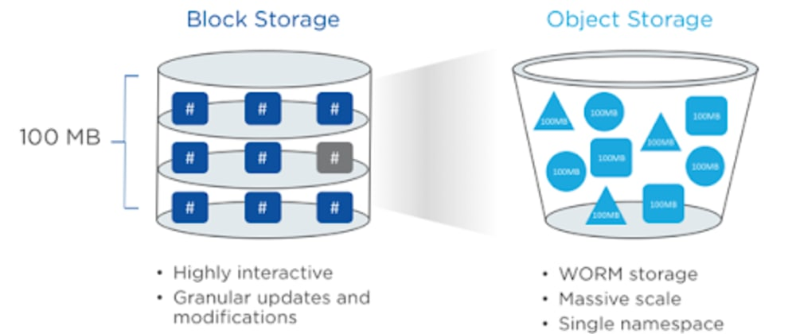

Slide 2
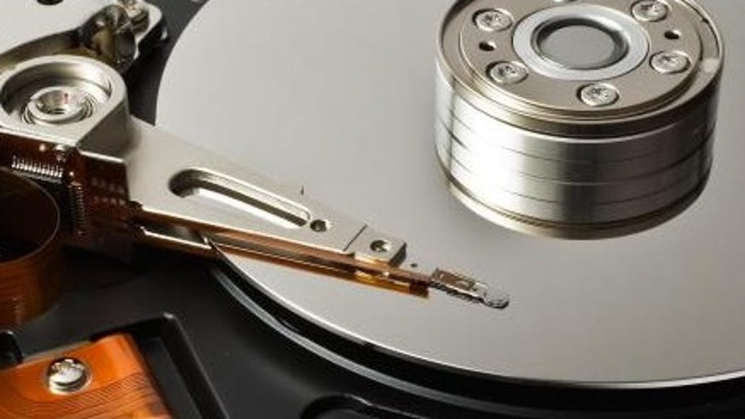

Slide 3
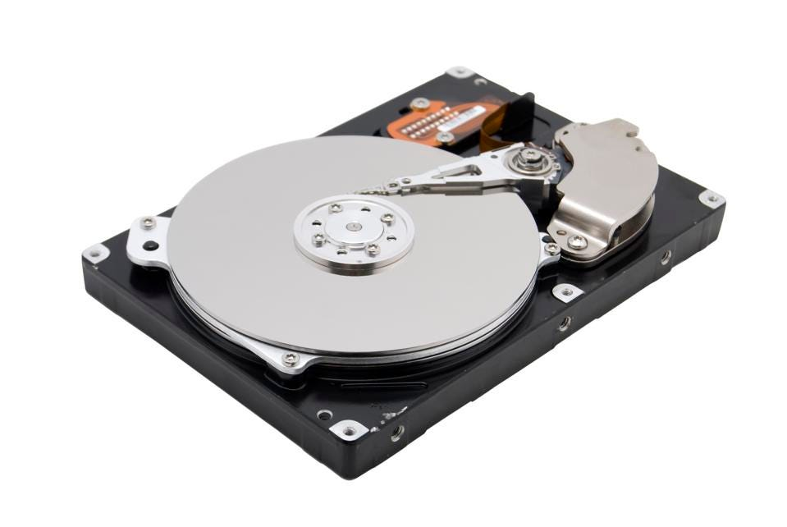

Slide 4
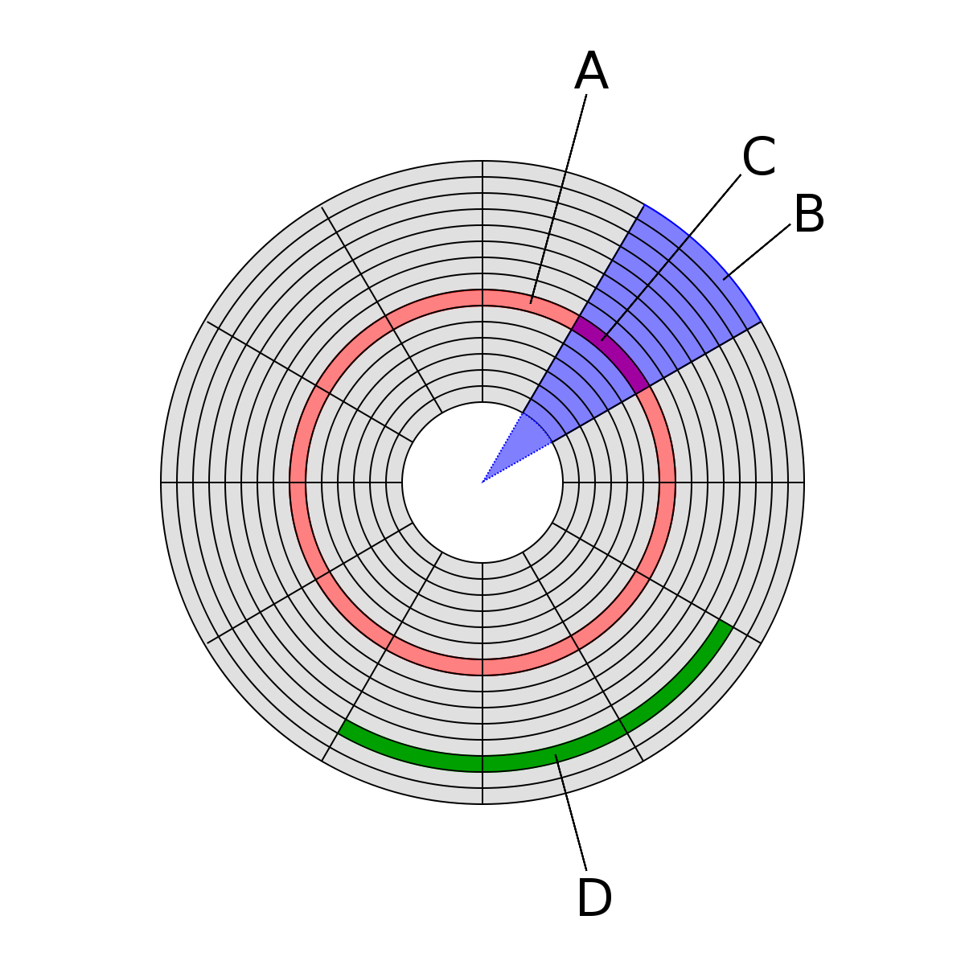
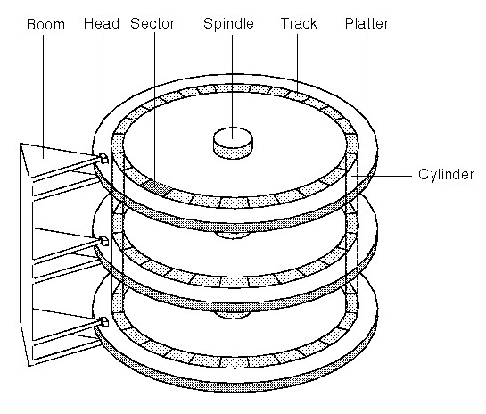
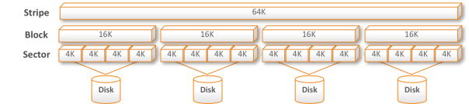

Slide 5
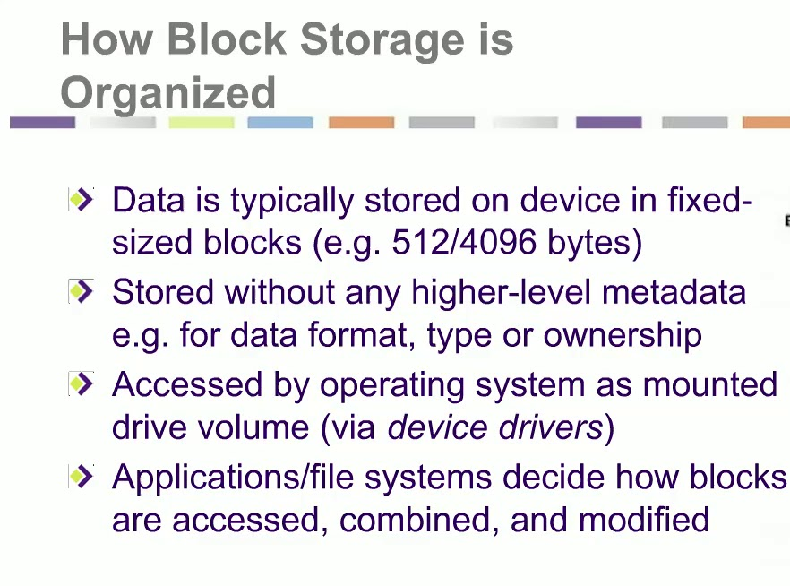
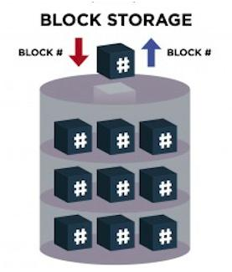

Slide 6


Slide 7
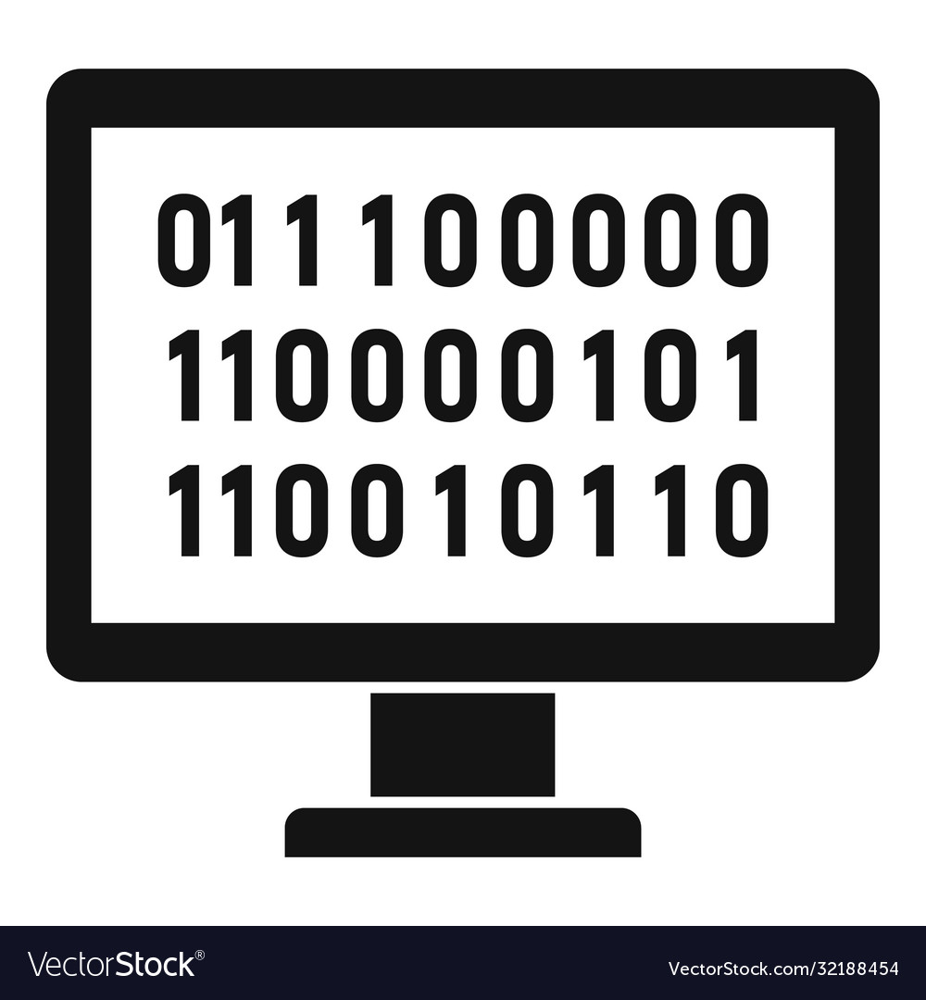



Hi
Status code 200
Status code 400
Hi, I am good
Hi, Hello, How Are you

Slide 8
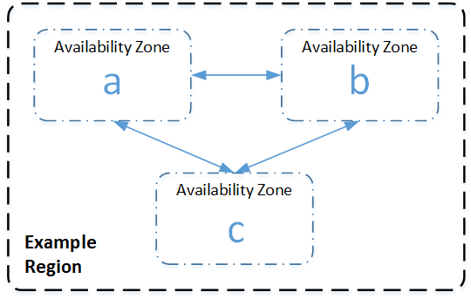

Put New Object
Upload’s 10GB File
Uploaded at 8:00:00
Replicated at 8:00:10
Replicated at 8:00:10

Slide 9
Put New Object – Two Scenarios
Upload’s 10GB File
Upload at 8:00:00
At 8:00:05
Request for file

Slide 10
Put New Object – Scenario 1
Request at 8:00:05
Upload’s 10GB File
Upload at 8:00:00

Slide 11
Put New Object – Scenario 2
Upload’s 10GB File
Upload at 8:00:00
Request at 8:00:05

Slide 12
Put Overwrite Object
Upload’s 10GB File
Upload at 8:00:00
Replicated at 8:00:10
Replicated at 8:00:10

Slide 13
Put Overwrite Object – Two Scenarios
Upload’s 10GB File
Upload at 8:00:00
At 8:00:05
Request for file

Slide 14
Put Overwrite Object – Scenario 1
Request at 8:00:05
Upload’s 10GB File
Upload at 8:00:00
New file/data

Slide 15
Put Overwrite Object – Scenario 2
Request at 8:00:05
Upload’s 10GB File
Old file/data
Upload at 8:00:00
Old file/data
Request at 8:00:05

Slide 16
Delete Object
Delete 10GB File
Delete at 8:00:00
Upload at 8:00:10
Upload at 8:00:10

Slide 17
Delete Object – Two Scenarios
Delete 10GB File
Deleted at 8:00:00
At 8:00:05
Check for file

Slide 18
Delete Object – Scenario 1
At 8:00:05 check for File
Delete 10GB File
No file found/return
Deleted at 8:00:00

Slide 19
Delete Object – Scenario 2
At 8:00:05
Check for file
File is present and Old file/data will be retuned
Delete 10GB File
Deleted at 8:00:00
File is present and Old file/data will be retuned
At 8:00:05
Check for file

Slide 20





Slide 21


